Slide 1









Data as Leverage: Understanding an Institution’s Teaching Culture
Paola Borin
Debra Dawson
Florida Doci
Donna Ellis
Lori Goff
Jill Grose
Sandy Hughes
Erika Kustra
Peter Wolf
POD Network – November 2014
Notes:
DE

Slide 2
Session Overview
Provide background on our multi-institutional teaching culture project
Share brief highlights of results to date from our pilot study involving surveys and focus groups
Contemplate key elements of teaching culture by reviewing revised survey instrument
Notes:
Session Timing: Total time = 75 minutes
Overview of project (slides 1-12) 15-20 minutes
Slides 1-8 (Donna)
Slides 9-12 (Deb)
Individual work: 10 minutes (Deb)
Small group discussion: 20 minutes (Deb)
Large group highlight reporting: 15 minutes (Donna)
Wrap-up: 5 minutes

Slide 3
The Provincial Political Terrain – Ontario, Canada
Metrics, metrics, metrics
Productivity and Innovation
Strengthening
centres of creativity innovation and knowledge
Differentiation
Strategic Mandates
Notes:
DE: What we’re up against in Ontario

Slide 4
What’s the place of teaching?
Start by studying an institution’s teaching culture
Organizational culture = Deep structure of an organization, rooted in organizational members’ values, beliefs, and assumptions (Denison, 1996)
We believe that one fundamental way to ensure quality teaching is to foster an institutional culture that values teaching = “teaching culture”
Notes:
DE: Where does teaching fit in the terrain?

Slide 5

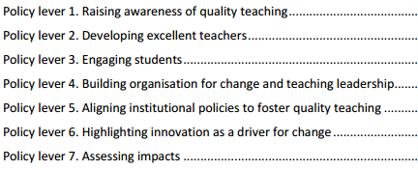
Teaching Culture – Initial Levers
Teaching is recognized in strategic initiatives and practices
Assessment of teaching is constructive and flexible
Faculty are encouraged to develop as teachers
Infrastructure exists to support teaching
Broad engagement around teaching occurs
http://www.oecd.org/edu/imhe/QT%20policies%20and%20practices.pdf
Notes:
DE

Slide 6
Our Project Aims
Engage with a variety of stakeholders to understand and document institutional teaching culture and how extensively teaching is valued
Raise the profile and importance of teaching in Canadian universities
Shift the way institutions, faculty, and staff think about teaching
Influence some of the metrics used to measure teaching and its value or importance
Notes:
DE: Very consultative process:
Staff from 8 different teaching centres have worked on project
STLHE, EDC, COED presentations and feedback (2013/2014)
COU presentation (2013)
Provincial government research funding (F2013) and now applied for national research funding

Slide 7
Anticipated Project Outcomes
Develop a survey instrument that identifies and provides evidence of prevailing perceptions regarding the teaching culture among key stakeholders – the Teaching Culture Perception Survey (TCPS)
Identify key institutional indicators to triangulate and confirm teaching culture
Develop a report template that institutions would receive following the completion of the inventory
Develop a recommendation package to help institutions choose practices that enhance their teaching culture
Notes:
DE

Slide 8
Phase 1 – Pilot Study – Teaching Culture Perception Surveys and Focus Groups
Two versions of the survey
  Students
  Faculty & Administration
Pilot survey at three institutions
  Windsor (n=921)
  Western (n=1589)
  McMaster (1334 participants)
Focus groups to collect survey feedback at each institution
Faculty & Administration
Notes:
DD: Our main focus today is the Faculty/administrator survey

Slide 9
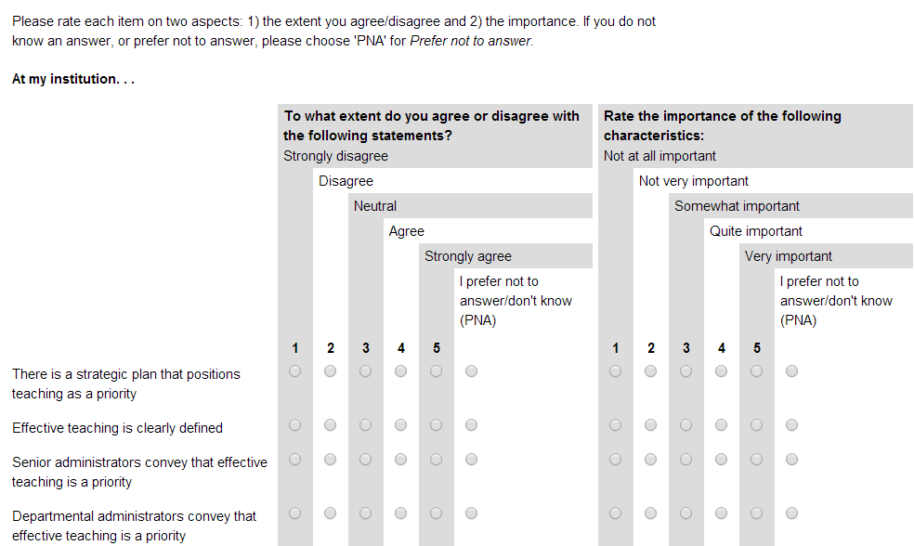
Teaching Culture Perception Survey (TCPS) Pilot
Assessment of agreement and importance ratings
Notes:
DD:
Aimed at examining the perceptions to develop a profile, allowing comparison between different stakeholders’ perceptions & comparison of change over time.
Questions designed to identify and validate indicators of quality teaching culture on campus.

Slide 10
Factor Analyses – Pilot Faculty TCPS
Agreement | Qs | Importance | Qs
1) Encouraging effective teaching (.92) | 16 | 1) Encouraging effective teaching (.94) | 17
2) Broad involvement around teaching (.88) | 11 | 2) Recognizing effective teaching (.90) | 12
3) Recognizing effective teaching (.73) | 4 | 3) Assessing teaching (.89) | 10
4) Assessing teaching (.78) | 6
* Various double-loadings occurred for both scales
Notes:
DD: # with Factor label = Cronbach’s alpha – The internal consistency of the items loading on a component will be assessed using Cronbach’s Alpha. This form of reliability indicates how well the items hang together on a component. Item deletion from a component will be considered if the alphas for that component are low (e.g., < .75) and deletion of a specific item will raise the alpha considerably.
DEB, WOULD YOU RATHER HAVE TABLE 7 (P.31) FROM THE PIF REPORT FINDINGS SECTION? (# RESPONDENTS, # ITEMS, ALPHA, MEAN, SD?
NOT SURE DIFFERENCES IN RESULTS (BELOW) IS KEY JUST NOW – MAYBE DO YOU WANT TO CONVEY THE SUBSCALE/FACTOR DEFINITIONS or SAMPLE ITEMS?
2) Summary of differences for the factors
a) Faculty:
Gender
Agreement: There were no gender differences.
Importance: Female faculty members rated all of the importance as more important than their male counterparts.
Appointment
Agreement: Contract/Sessional faculty agreed significantly less that their institution recognized effective teaching than their Tenured and Tenure Track colleagues.
Importance: Tenured faculty members rated all three of the importance subscales as of lesser importance than their Tenure Track and Contract/Sessional colleagues.
Years of Teaching Experience
Agreement: There were no significant differences based on the years of teaching experience.
Importance: There were significant differences for both the Support for Effective Teaching and Assessment of Teaching subscales such that faculty with 0-9 years experience rated both as more important than their colleagues with 10-19 and 20+ years of teaching experience.
Institution
Agreement: McMaster rated their agreement on the Assessment of Teaching significantly higher than their Western and Windsor counterparts (who did not differ than one another).
Importance: Western rated Support for Effective Teaching as less important than their colleagues from Windsor. Western faculty also rated Assessment of Teaching as less important than their colleagues from Windsor and McMaster.
b) Undergraduate students: [I cut these results, but the full table can be found in the removed slides area after the Thank You slide]
Gender
Agreement: Female undergraduate students agreed significantly more than their male counterparts that their institutions recognized effective teaching
Importance: Female undergraduate students rated Engaged Teaching, Access to Infrastructure, Recognition for Effective Teaching, Prioritization of Effective as more important than the men.
Program Year
Agreement: There were no significant differences based on the students’ year of program.
Importance: There were also no significant differences.
Institution
Agreement: For the undergraduate students at Windsor, their agreement on Effective Teaching, Access to Infrastructure, Support from Stakeholders, and Recognition for Effective Teaching was significantly lower than their Western and McMaster counterparts. Western and McMaster did not differ significantly.
Importance: There were no institutional differences.
b) Graduate students:
Gender
Agreement: There were no gender differences.
Importance: Female graduate students rated Effective Teaching and Recognition for Effective Teaching as more important than did their male counterparts.
Degree
Agreement: Master’s students agreed significantly more than PhD students that Effective Teaching, Access to Infrastructure, and Recognition for Effective Teaching was evident at their institutions.
Importance: Masters students rated Effective Teaching and Support from Stakeholder as more important than did their PhD counterparts.
Domestic or International Status
Agreement: International graduate students agreed significantly more that Effective Teaching, Access to Infrastructure, and Recognition for Effective Teaching were evident at their institutions than their domestic counterparts.
Importance: International graduate students rated the importance of Support for Stakeholders more highly than did their domestic colleagues.
Institution
Agreement: There were no institutional differences.
Importance: Windsor graduate students rated support from stakeholders as significantly more important than graduate students at Western or Windsor.
Semesters of being a TA or GA
Agreement: Less experienced TAs (0-2 semesters) agreed significantly more that Effective Teaching, Access to Infrastructure, and Recognition for Effective Teaching were evident at their institutions than their more experienced counterparts (3+ semesters).
Importance: TAs with 2 or fewer semesters experience as a TA rated effective teaching and support from stakeholders as more important than their colleagues who have been TAs for 3 or more semesters.

Slide 11
Faculty Focus Groups re: Pilot TCPS
More on rewards and incentives for quality teaching beyond awards (e.g., financial incentives, risk-taking incentives)
Value placed on teaching vs research
More on infrastructure (e.g., classrooms, technology, class size)
Specifics about teaching resources available for and used by instructors
More on evaluation of teaching
PLUS: consider changing the Agreement scale
Notes:
DD: NOTE: Just faculty feedback – taken from PIF report

Slide 12
Faculty TCPS Revisions
Lever 1: Institutional strategic initiatives and practices prioritize effective teaching
Lever 2: Assessment of teaching is constructive and flexible
Lever 3: Faculty are encouraged to develop as teachers
Lever 4: Infrastructure exists to support teaching
Lever 5: Broad engagement exists around teaching
Lever 6: Effective teaching is recognized and rewarded
Notes:
DD: Comment on change to Agreement scale as well
Remind them they have the 6 levers on the HO

Slide 13
Session Activity
Each small group is responsible for reviewing the questions for 2 of the revised TCPS levers
As individuals:
  Complete the survey for the 2 levers assigned to your group based on your perceptions of your institution
As a small group:
  Discuss your thoughts on the 2 levers assigned to your group – What items were problematic and why? What key items about teaching culture are missing from your levers? Need 1 recorder to capture your group’s feedback on provided sheet to submit.
As a large group – share highlights from discussions
Notes:
DD: Individual work: 10 minutes
DD: Small group discussion: 20 minutes
DE: Large group highlight reporting: 15 minutes
Remind them to check on the handout of the 6 levers to understand the levers broadly so they avoid suggesting ideas that may be addressed elsewhere

Slide 14
Future Work and Wrap-Up
Secure more research funding
Continue to refine and test survey instruments and collect qualitative data
Identify meaningful institutional indicators of a culture that is committed to teaching
Check our project website for more details: http://qualityteachingculture.wordpress.com/
Notes:
DE

Slide 15
References
Denison, D. R. “What is the difference between organizational culture and organizational climate? A native’s point of view on a decade of paradigm wars.” Academy of Management Review 21, no. 3 (July 1, 1996): 619-654.
Hénard, F. & Roseveare, D. (2012). Fostering quality teaching in higher education: Policies and practices. France: Organization for Economic Co-operation and Development. Retrieved from: http://www.oecd.org/edu/imhe/QT%20policies%20and%20practices.pdf
Notes:
Cut these refs:
Burke, Joseph C. 1998. “Performance Funding Indicators: Concerns, Values, and Models for State Colleges and Universities.” New Directions for Institutional Research. (97): 49–60.
Chalmers, D. (2008)Teaching and Learning Quality Indicators in Australian Universities, Conference proceedings of Institutional Management in Higher Education (IMHE), Paris France, September 8-12.
Warglien, M., & Savoia, M. 2001. Institutional Experiences of Quality Assessment in Higher Education - The University of Venice (Italy). Organisation for Economic Cooperation and Development (OECD).

Slide 16
Thank you!
Dr. Debra Dawson
Director, Teaching Support Centre
Western University
London, Ontario
dldawson@uwo.ca
Dr. Donna Ellis
Director, Centre for Teaching Excellence
University of Waterloo
Waterloo, Ontario
donnae@uwaterloo.ca

Slide 17
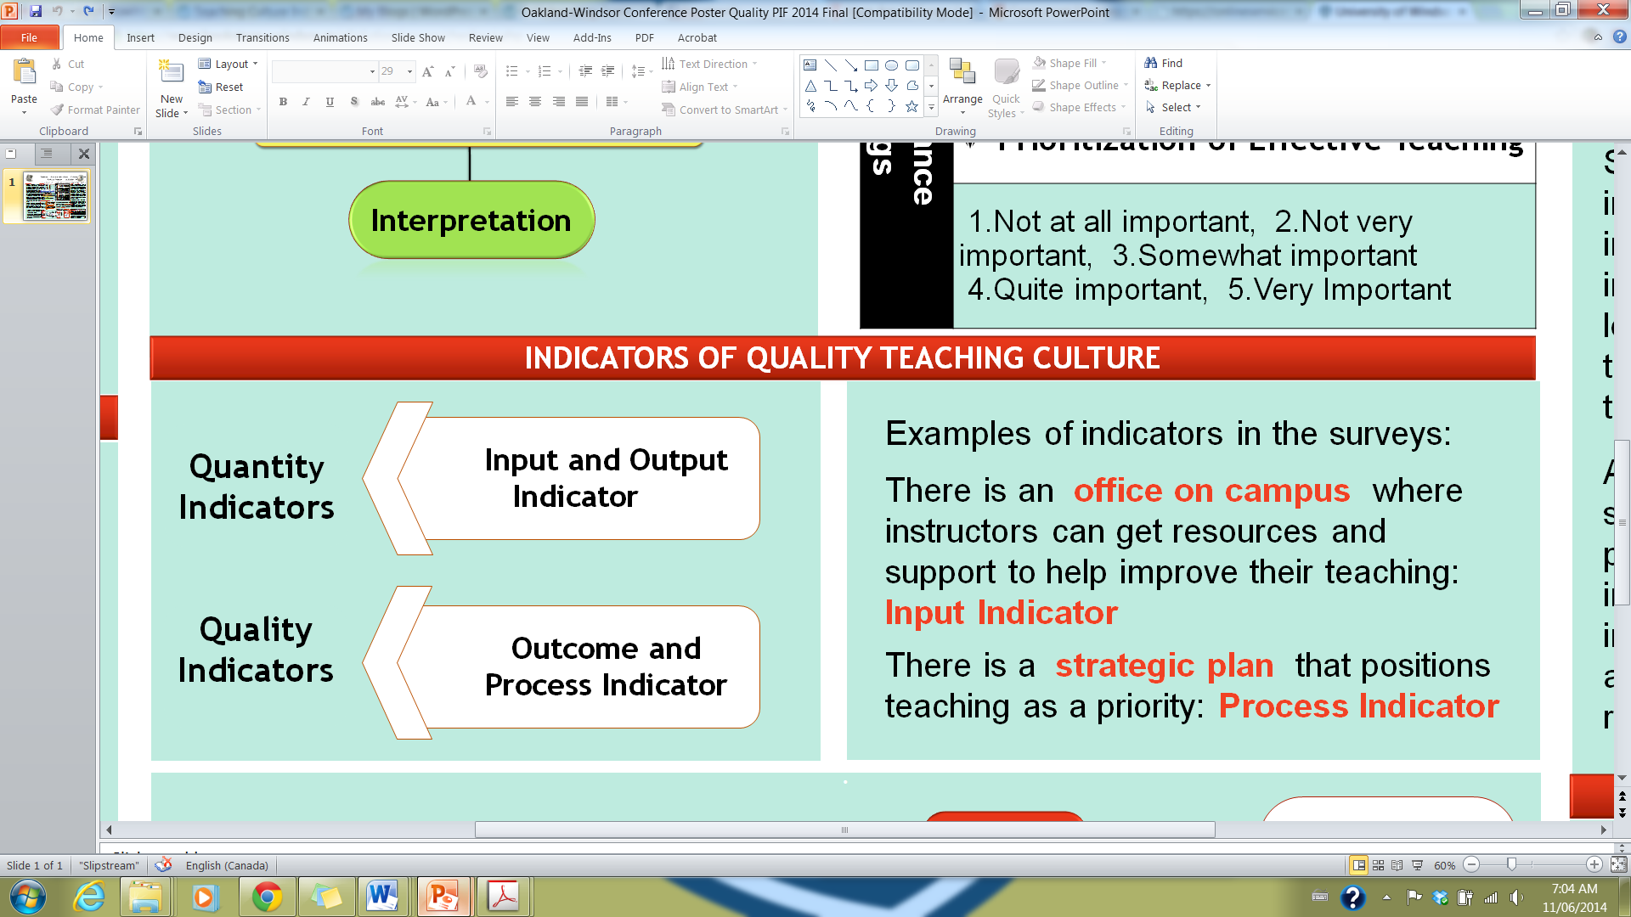
Phase 1 – Pilot Study – Teaching Culture Perception Survey
Aimed at examining the perceptions to develop a profile, allowing comparison between different stakeholders’ perceptions & comparison of change over time.
Questions designed to identify and validate indicators of quality teaching culture on campus.
Indicators are signals that reveal the progress or lack of progress towards a specific objective. (Chalmers 2008)

Slide 18
Phase 1 – Pilot Study – Identification and validation of indicators
Input: Resources involved in supporting an institutional program, activity or service.
Output: Reflect the quantity of outcomes, including measurable results and direct consequences of the activities implemented. (Bruke 1998)
Outcome: Focus on the quality of educational program, activity and service benefits for all stakeholders. (Warglien & Savoia 2001)
Process: Means used to deliver educational programs, activities and services within the institutional environment. (Bruke 1998)
Notes:
Input: Enrollment rates, resources & infrastructure, support services, expenditures etc
Output: Retention rate, success rate, graduation rate, graduate full-time employment etc
Outcome: Graduate satisfaction, employer satisfaction, graduate competencies, learning outcomes, student literacy level etc
Process: Student experience, professional development, teaching and learning plans and policies, appointment and promotion criteria, assessment and feedback policies etc

Slide 19
Phase 1 –Indicators
Examining the perceived existence (agreement ratings) and importance (importance ratings) of certain indicators related to quality teaching to develop a profile of the culture in the institution.
Triangulation of perception and facts to determine deviation from actual facts.
Identification of other indicators that speak to the culture of quality teaching.

Slide 20
Pilot Study Survey Factor Analyses
 | Agreement | Importance
Faculty | 1) Encouraging effective teaching (.92) | 1) Encouraging effective teaching (.94)
 | 2) Broad involvement around teaching (.88) | 2) Recognizing effective teaching (.90)
 | 3) Recognizing effective teaching (.73) | 3) Assessing teaching (.89)
 | 4) Assessing teaching (.78)
Undergraduate Students | 1) Implementing effective Teaching (.93) | 1) Implementing effective teaching (.79)
 | 2) Accessing infrastructure (.85) | 2) Broad involvement around teaching (.85)
 | 3) Broad involvement around teaching (.89) | 3) Accessing infrastructure (.84)
 | 4) Recognizing effective teaching (.71) | 4) Recognizing effective teaching (.80)
 |  | 5) Providing feedback on teaching (.83)
 |  | 6) Prioritizing effective teaching (.78)
Graduate Students | 1) Fostering and implementing effective teaching (.95) | 1) Implementing and enhancing effective teaching (.91)
 | 2) Accessing infrastructure (.86) | 2) Broad involvement around teaching (.87)
 | 3) Recognizing effective teaching (.77) | 3) Accessing infrastructure (.86)
 |  | 4) Recognizing effective teaching (.78)
Notes:
# with Factor label = Cronbach’s alpha – The internal consistency of the items loading on a component will be assessed using Cronbach’s Alpha. This form of reliability indicates how well the items hang together on a component. Item deletion from a component will be considered if the alphas for that component are low (e.g., < .75) and deletion of a specific item will raise the alpha considerably.
2) Summary of differences for the factors
a) Faculty:
Gender
Agreement: There were no gender differences.
Importance: Female faculty members rated all of the importance as more important than their male counterparts.
Appointment
Agreement: Contract/Sessional faculty agreed significantly less that their institution recognized effective teaching than their Tenured and Tenure Track colleagues.
Importance: Tenured faculty members rated all three of the importance subscales as of lesser importance than their Tenure Track and Contract/Sessional colleagues.
Years of Teaching Experience
Agreement: There were no significant differences based on the years of teaching experience.
Importance: There were significant differences for both the Support for Effective Teaching and Assessment of Teaching subscales such that faculty with 0-9 years experience rated both as more important than their colleagues with 10-19 and 20+ years of teaching experience.
Institution
Agreement: McMaster rated their agreement on the Assessment of Teaching significantly higher than their Western and Windsor counterparts (who did not differ than one another).
Importance: Western rated Support for Effective Teaching as less important than their colleagues from Windsor. Western faculty also rated Assessment of Teaching as less important than their colleagues from Windsor and McMaster.
b) Undergraduate students:
Gender
Agreement: Female undergraduate students agreed significantly more than their male counterparts that their institutions recognized effective teaching
Importance: Female undergraduate students rated Engaged Teaching, Access to Infrastructure, Recognition for Effective Teaching, Prioritization of Effective as more important than the men.
Program Year
Agreement: There were no significant differences based on the students’ year of program.
Importance: There were also no significant differences.
Institution
Agreement: For the undergraduate students at Windsor, their agreement on Effective Teaching, Access to Infrastructure, Support from Stakeholders, and Recognition for Effective Teaching was significantly lower than their Western and McMaster counterparts. Western and McMaster did not differ significantly.
Importance: There were no institutional differences.
b) Graduate students:
Gender
Agreement: There were no gender differences.
Importance: Female graduate students rated Effective Teaching and Recognition for Effective Teaching as more important than did their male counterparts.
Degree
Agreement: Master’s students agreed significantly more than PhD students that Effective Teaching, Access to Infrastructure, and Recognition for Effective Teaching was evident at their institutions.
Importance: Masters students rated Effective Teaching and Support from Stakeholder as more important than did their PhD counterparts.
Domestic or International Status
Agreement: International graduate students agreed significantly more that Effective Teaching, Access to Infrastructure, and Recognition for Effective Teaching were evident at their institutions than their domestic counterparts.
Importance: International graduate students rated the importance of Support for Stakeholders more highly than did their domestic colleagues.
Institution
Agreement: There were no institutional differences.
Importance: Windsor graduate students rated support from stakeholders as significantly more important than graduate students at Western or Windsor.
Semesters of being a TA or GA
Agreement: Less experienced TAs (0-2 semesters) agreed significantly more that Effective Teaching, Access to Infrastructure, and Recognition for Effective Teaching were evident at their institutions than their more experienced counterparts (3+ semesters).
Importance: TAs with 2 or fewer semesters experience as a TA rated effective teaching and support from stakeholders as more important than their colleagues who have been TAs for 3 or more semesters.

Slide 21
CUT?? Pilot Study Focus Group Results
Noted indicators of a teaching culture that values teaching:
Students:
Faculty:
Current and supported best practices
Professors’ behaviour
Passion
Teacher accessibility
Valid assessment tools
Implementation of student feedback
Promotional incentives for teaching
Support for teaching
Infrastructure
Research above teaching
Teaching evaluations
Notes:
Comments and examples for each point

Slide 22
Phase 2
Teaching Culture Institutional Indicators
Identify indicators that are available at the majority of Ontario institutions
Most highly correlated with or predictive of a teaching culture
____ Evidence of ‘course and curriculum improvement’ funds
____ Evidence of a well-developed strategic plan for enhancing the undergraduate learning experience
____ Evidence of senior leadership devoted to undergraduate teaching & learning
Notes:
Lori
2:10

